Slide 1
Workforce Outcomes: Job-Based Perspective
George W. Putnam Illinois Department of Employment Security
2016 College Changes Everything
July 21, 2016

Slide 2
Why the Emphasis on Employment Outcomes?
Gradual shift in educational policy from
Access
Completion
Completion for What?
Information technology infrastructure usually lags behind the policy changes.

Slide 3
College Access
The Illinois Board of Higher Education has 20 years of enrollment information that it has captured from all degree-granting institutions in the state.
IBHE is also statutorily required to submit an underrepresented groups report.
With our old information system we were able to determine the racial composition of the system as a whole as well as the different sectors of the system.
We were also able to establish and examine trends
It didn’t get at retention or time to completion.

Slide 4
Degrees
IBHE has been systematically tracking degree production for 20 years.
Our current system allows for disaggregation by sector, degree level, race, gender, and program
http://www.ibhe.org/EnrollmentsDegrees/Search.aspx
It allows for the development of trends
The unit of measurement is the institution, not the individual
There is a disconnect between enrollment and degrees
Until recently, our knowledge was limited to what happened in the postsecondary space
No way to tell if the supply was actually meeting the employer demand

Slide 5
Completion
Reflected in the Public Agenda for College and Career Success and IBHE’s performance funding formula
The Completion Agenda
60% of the working age adults with a high quality credential or degree by 2025
Assessed with either a) population-based metrics, or b) aggregating all degree production in the state

Slide 6
The Lumina Foundation. (2016). A Stronger Nation. Indianapolis, IN.

Slide 7
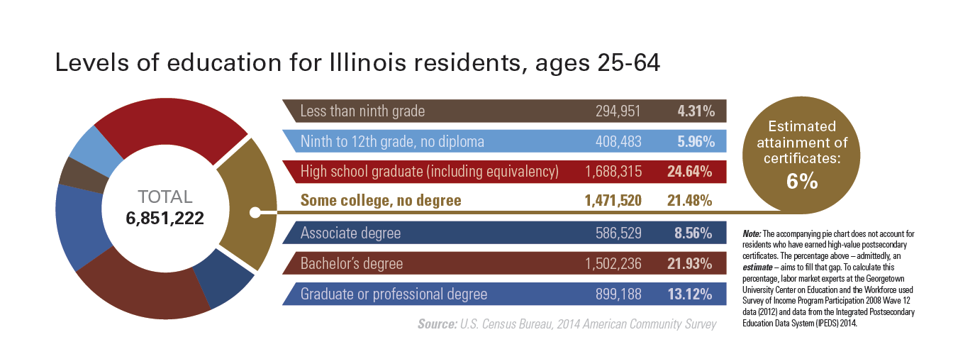
The Lumina Foundation. (2016). A Stronger Nation. Indianapolis, IN.

Slide 8
Recent Award Production in Illinois
Relative to Projected Need

Slide 9
Relative Change in the Number of Bachelor’s Degree Awarded at Illinois Public Universities: 2014 to 2004

Slide 10
Completion for What?
Are graduates successful in their attempts to enter the workforce?
How long did it take them to enter the workforce?
Are they working in occupations related to their program?
How stable is their employment?
How do they perform relative to individuals with other majors, from different schools, to other workers?
If they aren’t working are they continuing their education?

Slide 11
Data and Research Partnerships
Agencies have limited resources and required to meet statutory requirements
Collaborate with other agencies
Collaborate with researchers at universities and centers

Slide 12
Data and Research Partnerships
Meet the demand for quality research
Unbiased and politically neutral
Add to and complement agency capacity
Integrate both policy and academic approaches to analysis and problem solving.
Partnerships can provide needed specialized expertise to support state/local policy.
Notes:
Depending on the researcher and the partnership, there can be quite a bit of overlap between

Slide 13
Data and Research Partnerships
Research is a specialty field: most researchers focus on just a few areas and become expert in them.
Partnering with external researchers allows agencies the flexibility to get the “best of breed.”
Match agency needs with the best mix of technical skills, content knowledge, and interest in policy work.
The relationship lasts only as long as necessary.

Slide 14
Partnerships
Achieving flexible capacity based on need for methodological or topical expertise
Tapping in-demand talent that would otherwise be out of reach
Providing fruitful connections between policy, research, and practice
Finding partners with the right expertise, interest, availability, and skill sets
Finding resources to fund the research
Competing priorities
Benefits
Potential Drawbacks

Slide 15
Workforce Outcome Narratives
Individual-based measures
Unit of analysis: SSN
Workforce outcomes
Outcome comparisons linked to program completion, but disconnected from labor market status
reference group comparisons are often misleading
Job-based measures
Unit of analysis: pairing of SSN and Employer UI Account
Workforce outcomes
Outcome comparisons link program completion to labor market status
labor market status enhances cross-sectional and time-series reference group comparisons
Conventional Narrative
Enhanced Narrative

Slide 16
Job-Based Workforce Outcomes
Job stability as key determinant of labor market status
Hire as start point
Separation as end point
Outcome comparison between training graduates and all IL worker (US Bureau of Census)
Conventional measures understate earnings outcomes
Impact of partial employment on earnings
Impact of dual jobholding on earnings
Career job- highest paying job held for 3 consecutive quarters
Mapping career job flows- industry and earnings

Slide 17
Example 1
2011 and 2012 graduates from a healthcare training program in a central Illinois county
Graduates were not enrolled in any other post-secondary training program from time of graduation through the beginning of 2016

Slide 18
Post-graduation, job stability for Hlth Grads improves markedly; second year post-graduation, job stability for Hlth Grads nears 80%

Slide 19
First year post-graduation, job stability for Hlth Grads is similar to All Hlth Workers (age 22-24); second year post-graduation, job stability for Hlth Grads is higher

Slide 20
Second year post-graduation, job stability for Hlth Grads is higher than All Hlth Workers (age 25-34)

Slide 21
First year post-graduation, earnings for Hlth Grads is equal to All Hlth Workers age 25-34; second year post-graduation, earnings growth is 15% Hlth Grads and only 4.8% for All Hlth Workers age 25-34

Slide 22
Summary of Findings
Example 1- healthcare grads from county in central Illinois
Focus- comparing outcomes for graduates from a local institution to other IL workers in the same local labor market (county, industry and age)
Post graduation, job stability of graduates improves markedly and by the second year exceeds other IL healthcare workers age of the same age
By the second year post-graduation, overall earnings and earnings growth is higher for Hlth Grads than other Hlth Workers of the same age

Slide 23
Example 2
2012Q2 completers from statewide training program for WIA/Trade
WIA programs serve Adults, Dislocated Workers, and Youth
Trade program serve individuals who lose their job for NAFTA/TAA related reasons
Completers represent those who exited the training program for reason of entered employment

Slide 24
Post-exit, job stability for completers improves markedly; second year post-exit, vets outperform other completers and equal other IL workers

Slide 25
Vet completers earn more than a 20% premium over other completers at the time of exit ($2,718 vs $2,221); 15% premium throughout the period ($2,955 vs $2,581)

Slide 26
Vet earnings outpace other completers in the same industry by 25% ($2,561 vs $2,057); Vets in health jobs realize an average over-the-year earnings gain of nearly 14.5%, other completers only 6.9%

Slide 27
Monthly earnings is similar for older vets and all vets in the health industry ($2,536 vs $2,561); monthly earnings is less for older completers than all completers ($1,950 vs $2,057)

Slide 28
Summary of Findings
Example 2- completers from statewide training programs for WIA/Trade
Focus- comparing outcomes for subpopulations of training completers ( vets vs others) to IL workers in the same industry and age
Within two years of exit, completer job stability is similar to other Illinois workers, although more so for veteran completers
Structural distinction in earnings between veteran completers and other completers at time of placement remains evident throughout two-year study
Health industry may offer high returns to experience and placement of older completers in this industry may mitigate earnings potential

Slide 29
Integrating Information Platforms: Informed Student Choice, Career Readiness and Workforce Outcomes

Slide 30
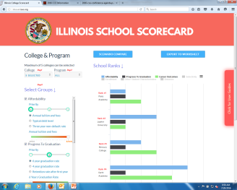
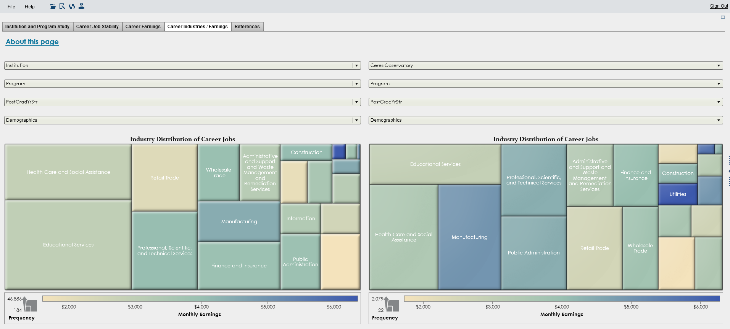
The Delivery Platform
The delivery platform is a cost-effective dual platform approach that includes,
A Web based solution that emphasizes ease of use, navigation and user choice
A SAS Visual Analytics based solution that emphasizes research and analysis for large data sets
Prototype

Slide 31
The Web based solution
Eventual target audience – Parents, Students
Ability to scale for a large number of concurrent users
Highly cost-effective
Mobile Responsive Solution
Technology
High charts – A highly responsive integrating charting solution
HTML5, CSS3, JQuery

Slide 32
The Research & Analysis solution
Target audience – Analysts, Researchers
Ability to work with very large data sets
Secure environment – Login needed
Ability to disclosure proof with variable cell size limits
Limited by functionality of SAS Visual Analytics
Computing intensive
Technology
SAS Visual Analytics (internally uses Hadoop)

Slide 33
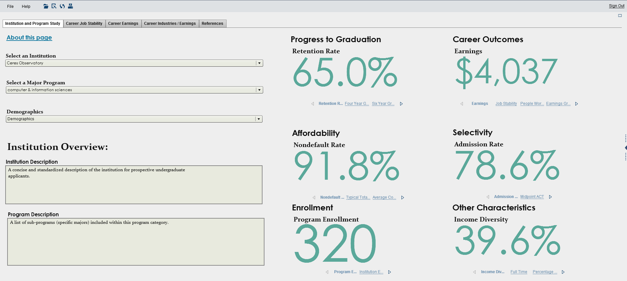
The Research & Analysis solution
Institution and Program of Study

Slide 34
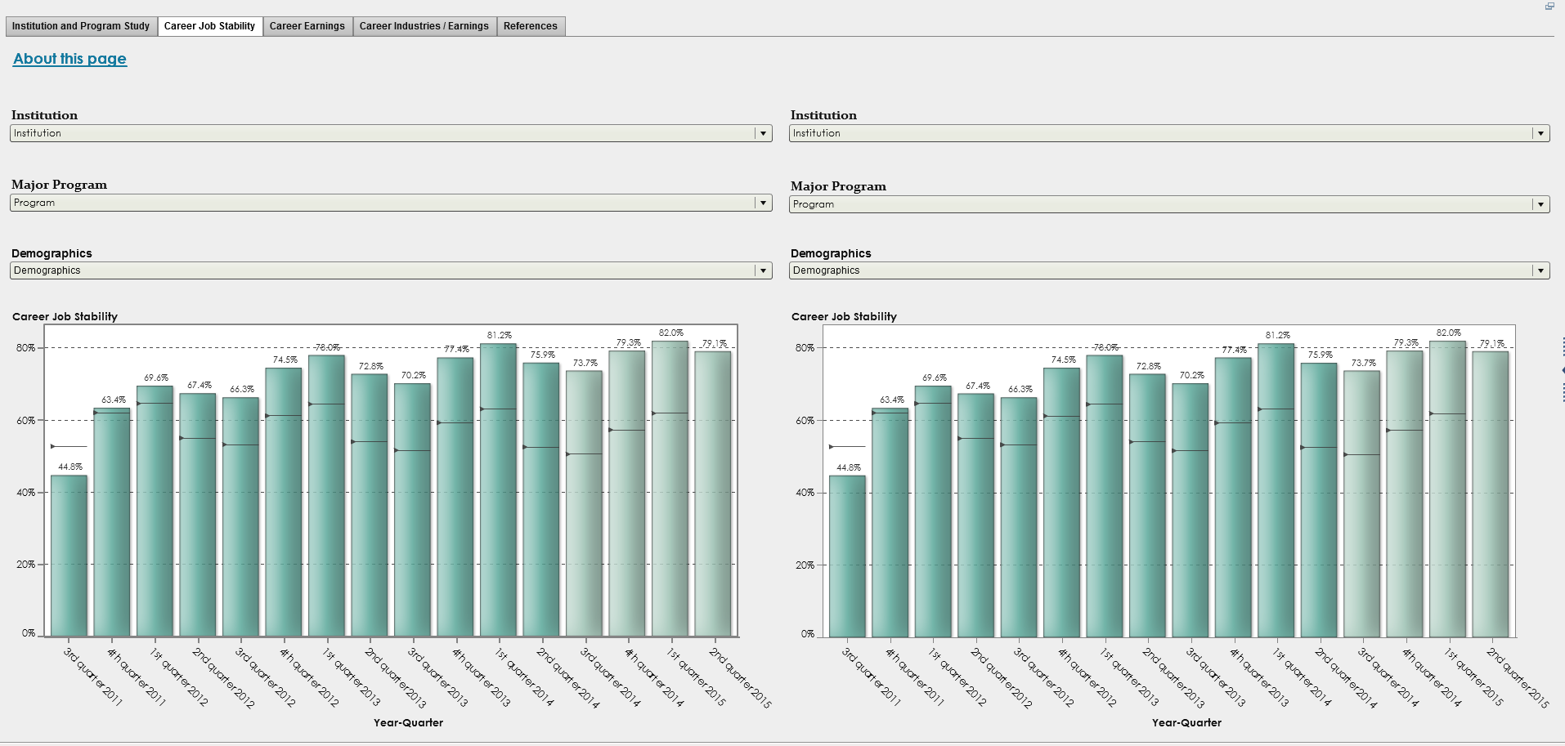
The Research & Analysis solution
Career Job Stability

Slide 35
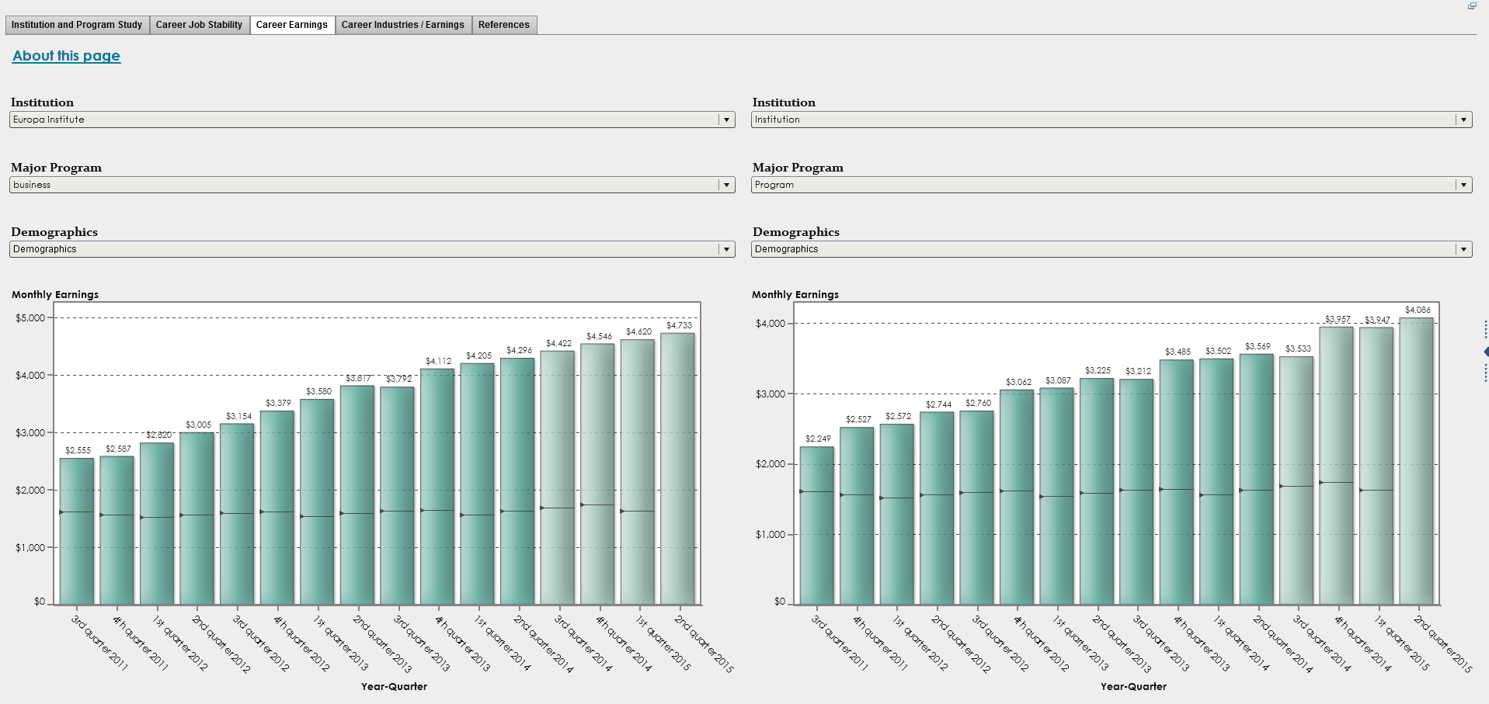
The Research & Analysis solution
Career Earnings

Slide 36
The Research & Analysis solution
Career
Industries/ Earnings

Slide 37
Next Steps
Stakeholder Discussions
Data Processing
Prototype to Production
User Focus Groups for design
Scale the scorecard – Infrastructure, technical design
Scale the SAS VA environment

